Slide 1
Lesson 1 - What is Bootstrap?
Mr Mack 2019

Slide 2
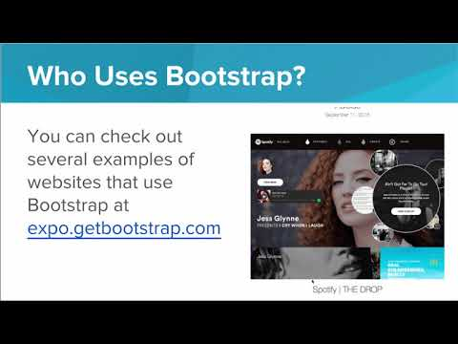
What is Bootstrap?

Slide 3
Example Bootstrap Mobile Site
In this unit, you’ll be learning how make mobile responsive websites using Bootstrap!
Bootstrap is framework for developing responsive, mobile websites. It’s like a toolbox for web developers. It provides helpful, reusable components like navigation bars and buttons, so that the web developer doesn’t have to reinvent the wheel over and over again.
Bootstrap also helps automatically make your website responsive - meaning your website will react to the window changing size. Rather than everything getting smushed together, you can use Bootstrap to tell the browser how to reorganize your website when the browser window gets smaller and larger.
Because Bootstrap sites are responsive, they also look great on mobile devices!
Here is an example mobile website made with Bootstrap. This is the kind of site you’ll be able to create by the end of this unit.

Slide 4
Real World Bootstrap: OneNYC
Millions of real websites are built with Bootstrap. This is one example of a real world website made with Bootstrap.
Try resizing the window and see how the site responds.
Explore parts of this site to gain inspiration for your own project. Notice how this site implements its top navigation bar, buttons, etc. What do you like about this design? What don’t you like?

Slide 5
Exercise 6.1.1: Responsive vs Unresponsive
What does it mean for a website to be “responsive”?
Name one common framework that is used by web developers to build responsive websites.
Find one example of a responsive website and paste a link here.
Find one example of an unresponsive website and paste a link here.

Slide 6
Exercise 6.1.2: Favorite Bootstrap Site
Millions of websites are built with Bootstrap.
In this activity, you’ll find one that resonates with you.
Go to http://expo.getbootstrap.com/ to explore a collection of websites built with Bootstrap. Pick out one that you like and paste a link here in your response, and answer the following questions.
What is the purpose of this website?
What do you like about this site design?
What is one thing on this website that you would like to use in your own website design?

Slide 7
Getting Started with Bootstrap

Slide 8

Getting Started with Bootstrap

Slide 9
What is the difference between .container and .container-fluid?
.container-fluid keeps margins to the left and right of the content, while .container fills the entire width of the window.
.container-fluid is responsive to the window size, while container creates a fixed width that never changes, regardless of window size.
.container-fluid constantly updates to fit the width of the window, while .container will update occasionally as the window is resized.
.container should be used in headers, while .container-fluid is used for p tags.

Slide 10
True or False: If you use Bootstrap’s framework for your site, you can’t add your own CSS rules.
True
False

Slide 11
Example: First Bootstrap Page
This is an example for this lesson. You are encouraged to play around with it, run and change the code, and learn how it works. When you are done, click continue to go to the next problem.

Slide 12
Example: Container-Fluid Page
This is an example for this lesson. You are encouraged to play around with it, run and change the code, and learn how it works. When you are done, click continue to go to the next problem.

Slide 13
Exercise 6.1.1: 1. Photo Portfolio
Throughout this module, you will create a portfolio website using what you learn in each lesson! You can see a sample finished site here: Sample Site
In this challenge, you will get the basic skeleton implemented. index.html will be the homepage of the site. On this page, you should create a div with the classes container-fluid and cover. cover has been defined for you in style.css.
Inside of the container, give the site a title that describes whose site this is using an <h1> tag.
Under the <h1> tag, create three links labelled Galleries, Pricing, and Contact. They should link to gallery.html, pricing.html, and contact.html. These pages don’t exist yet, but they will be added in later challenges.
The links should be styled using <h1> tags.

Slide 14
Container Docs
This is the official documentation from Bootstrap about Containers.
You can also find it here: http://getbootstrap.com/css/#overview-container
For more information, check out w3school’s documentation:
https://www.w3schools.com/bootstrap/bootstrap_get_started.asp

